Slide 1
BIG MOUNTAIN SKI RESORT
Ticket Pricing Strategy

Slide 2
PROBLEM IDENTIFICATION
- What opportunities exist for Big Mountain Ski Resort to create a new competitive ticket price that will maximize revenue on its facilities by the end of the fiscal year.
- In addition, the installation of new chair lift bring additional operating cost of $1.54 million. What can we do to reduce operating cost without affecting revenue or ticket price

Slide 3
Recommendation and Key Findings
During our analysis, our model predicted a ticket price of $95.87, suggesting there is room for an increase.
After evaluating various scenarios we have several options to recommend:
increase ticket price by $1.99 coupled with strategic facility enhancements such as increasing vertical drop. This will bring additional 1.94 million revenue increase, enough to cover operating cost of chair lift addition
To reduce cost, we opt to close one run which will not affect revenue/ticket price

Slide 4
MODELING RESULTS AND ANALYSIS:
We explore different model scenarios to find optimal ticket price. Our model came up with predicted price of 95.87 and MAE of 10.39 suggesting Big Mountain may undervalue its ticket price and not making the most of its facilities.
The Random Forest Model is our winning model of choice because it has lower MAE and superior reliability.

Slide 5
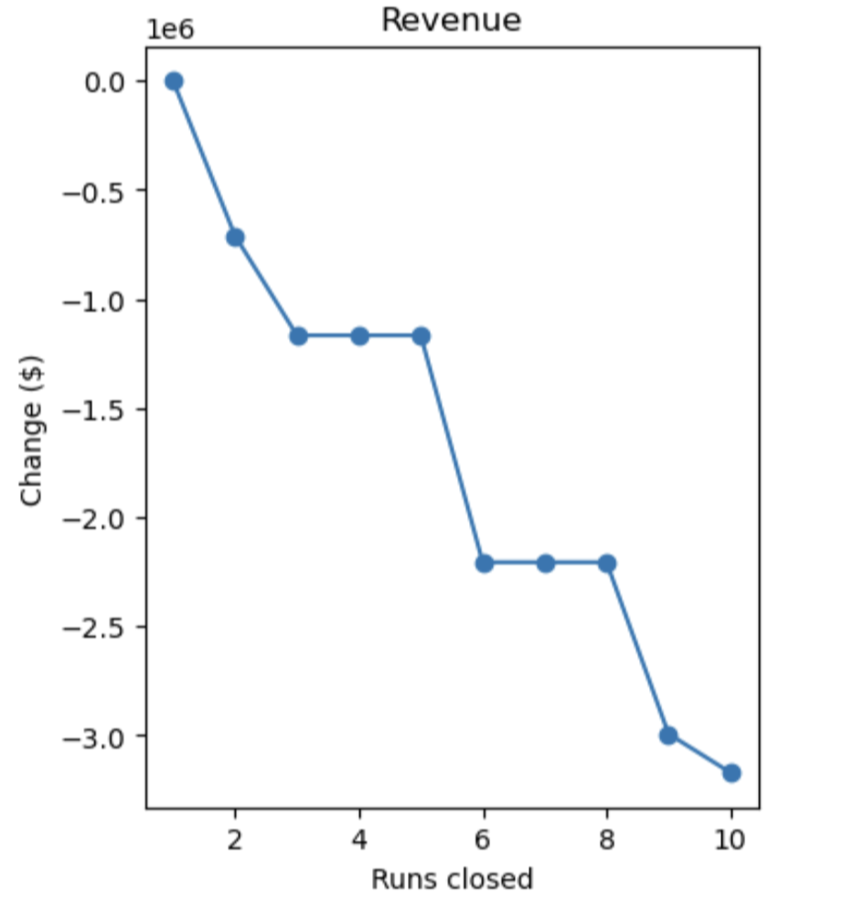
MODELING RESULTS AND ANALYSIS
We modeled various scenarios to explore ways to increase revenue or reduce cost
Ticket price increase coupled with facilities enhancement such as increasing vertical drop will bring significant revenue gain, given the expected visitors of 350000
On the other hand, we can cut cost by closing unused runs. As seen in the left graph, closing one run will not affect revenue/ticket price, closing 3,4,5 runs will have the same effect , but closing more than 5 runs, will significantly drop revenue.

Slide 6
MODELING RESULTS AND ANALYSIS:
Based on our evaluation of model scenarios, we find that we can increase revenue by raising ticket price supported with facilities enhancements such as: increasing vertical drop, adding new runs, which will bring additional 1.94 million revenue increase
Alternatively, we can reduce cost (which will also increase revenue) by closing unused run. We should choose to close one run first, as this will not affect revenue/ticket price

Slide 7
SUMMARY and CONCLUSION
Raising ticket prices by just a mere $1.99, in tandem with facility enhancements such as vertical drop increase and new runs addition, will bring additional revenue increase of $1.94 million, enough to cover additional operating cost from installing a new chair lift
Closing one unused run will reduce operating cost without affecting revenue/ticket price
We could utilize additional data such as cost and expense, skiers demographic, competitor price etc., to get more thorough and detailed analysis.

